Slide 1
ASSET LIABILITY MANAGEMENT SYSTEM
Team Members: Date:
Charan Panuganti 25-07-2025
Jyothi Narsini
Kanishk Singh Batch Details:
Niyati Negi Bangalore-Batch 3
Varsha Teeratipally

Slide 2

🔹
Agenda:
Problem Statement
Objective
Tools & Technologies
ALM Service Components
System Architecture
Implementation Details
Static Code Analysis Tools
Results
Challenges faced
Learnings & Takeaways

Slide 3
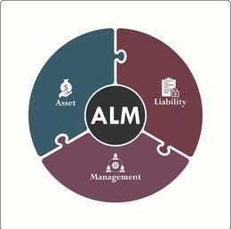
🔹
Problem statement
The problem statement for the Asset Liability Management (ALM) System is to tackle the risks financial institutions face due to imbalances between assets and liabilities, which can lead to financial instability and reduced profitability. These imbalances expose institutions to vulnerabilities from interest rate volatility, insufficient liquidity, and currency fluctuations. The system must deliver capabilities to quantify and evaluate these risks by computing the gap between interest-sensitive assets and liabilities, assessing the profitability of interest-earning activities, analyzing how asset and liability values respond to interest rate shifts, estimating potential losses from market risks, monitoring cash flow disparities across time periods, and determining the capacity to cover debts with tangible assets, thereby supporting robust risk mitigation and strategic financial planning.

Slide 4
🔹
Objective
Comprehensive Inventory
Maintain detailed records of assets and liabilities by type, amount, interest rate, and maturity.
Key Metric Computation
Automate calculation of:
Gap Analysis
Net Interest Margin (NIM)
Duration Gap
Liquidity Gap
Asset Coverage Ratio
Secure, Role-Based Access
Implement authentication and authorization for Admins, Moderators, and Users.
Risk & Liquidity Assessment
Analyze market risks via time buckets, VaR, liquidity trajectories.
Decision Support
Enable informed interest-rate and liquidity risk management through dashboards and alerts.

Slide 5
Tools & Technologies
Layer | Technologies
Backend | Java 17, Spring Boot 3.5.3
Database | MySQL 8.0 (users, assets, liabilities, income, market data, time buckets)
Frontend | Oracle Javascript Extension Toolkit(OJET) v1 8.0
Development | SpringToolSuite4, Maven 3, Postman,VS Code
Reporting | PMD, Spotbugs, CheckStyle

Slide 6
ALM Service Components
Asset Coverage Service
Calculates the Asset Coverage Ratio by comparing asset values (minus intangibles) against liabilities and debt.
Asset Service
Handles CRUD operations for asset entities (create, read, update, list).
Duration Gap Service
Computes the Duration Gap: DA – (DL × Liability/Asset ratio) to assess interest rate sensitivity.

Slide 7
Gap Analysis Service
Executes Gap Analysis across time buckets: RSA – RSL to identify liquidity mismatches.
Liability Analysis Service
Manages CRUD and analytics for liabilities, including maturity profiles and durations.
Liquidity Gap Service
Measures Liquidity Gap by comparing maturing assets and liabilities per bucket.
NIM Service
Determines Net Interest Margin: (Interest Income – Interest Expense) / Average Earning Assets
.
VaR Service
Calculates Value at Risk (VaR) using portfolio holdings, market data, and confidence intervals.

Slide 8
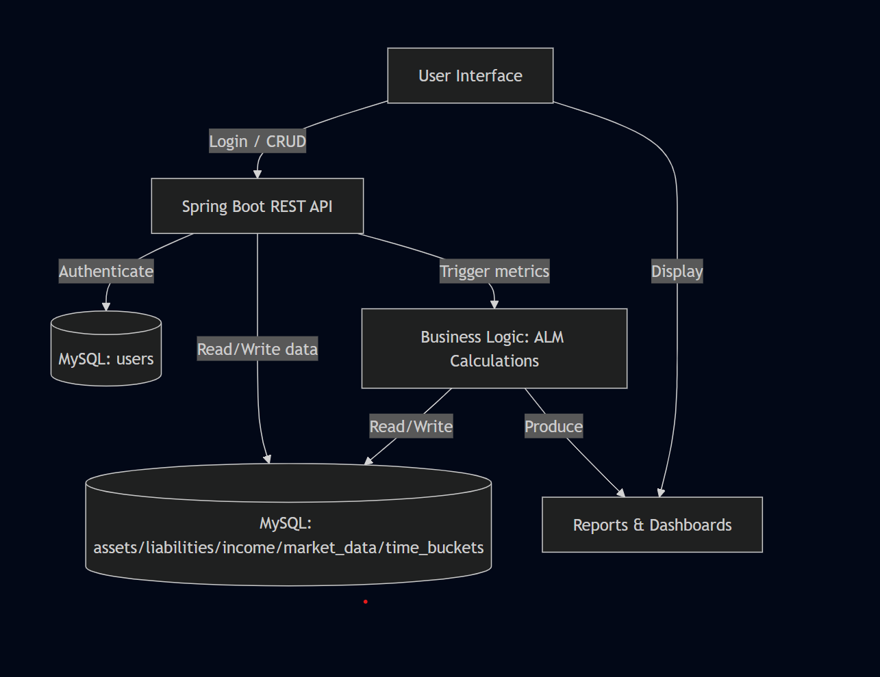
System Architecture

Slide 9
Implementation Details
Requirement Analysis
Defined essential ALM metrics and reporting needs
Database Design
Created schema: users, assets, liabilities, income_statements, market_data, time_buckets using MySQL
Loaded dummy data using csv files
Backend Development
Initialized Spring Boot project in STS4
Defined entities, repositories, services, and controllers
Business Logic Services
Gap, NIM, Duration Gap, Liquidity Gap, Asset Coverage services
Integrated time-bucket logic
Frontend Development
Built interactive UI with dynamic charts illustrating key metrics using OJET
Testing
Utilized Postman to verify API behavior
Cross-checked ALM outputs against expected results
Deployment
Launched on local server (Tomcat with Spring Boot embedded)
Ensured robust JDBC connectivity to production-grade MySQL

Slide 10
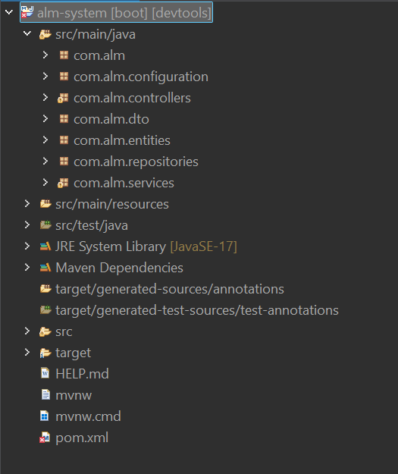
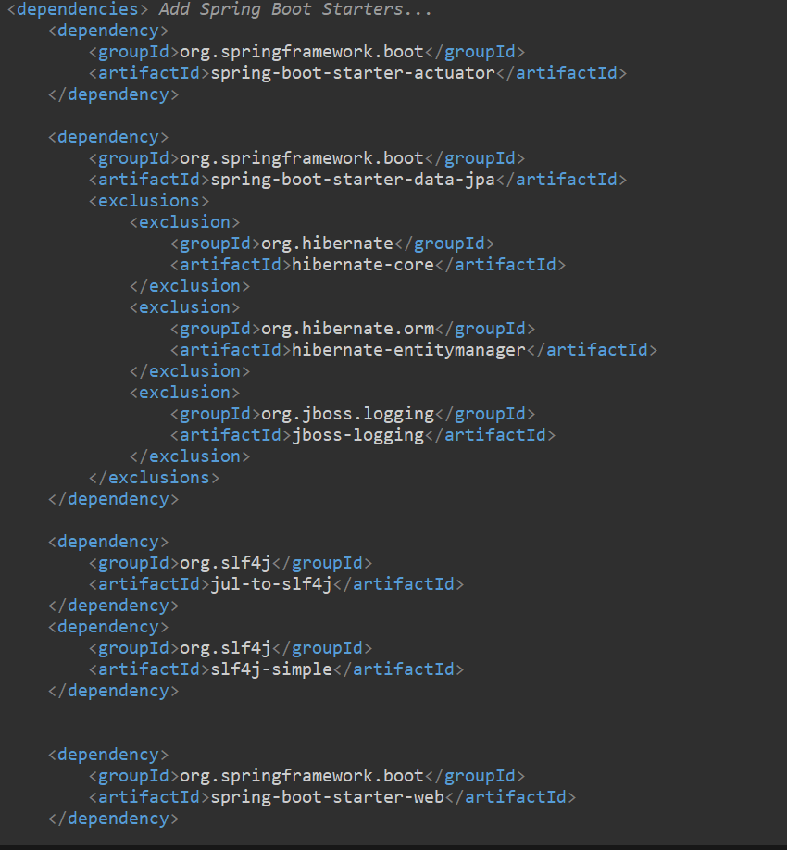
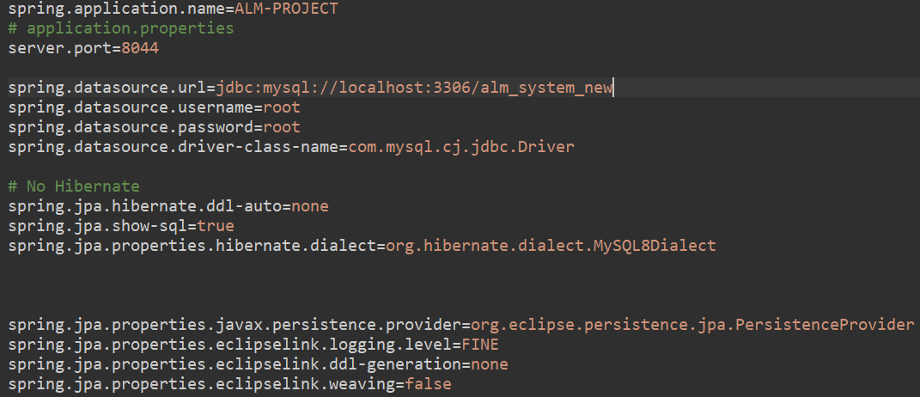
Back-End Structure
File Structure Some Dependencies in pom.xml
Spring-Boot Configurations

Slide 11
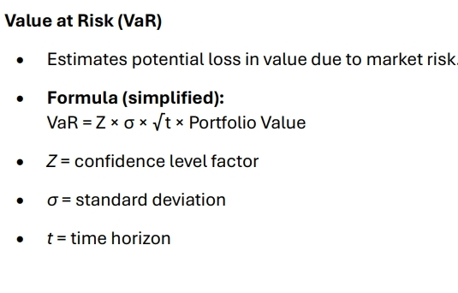
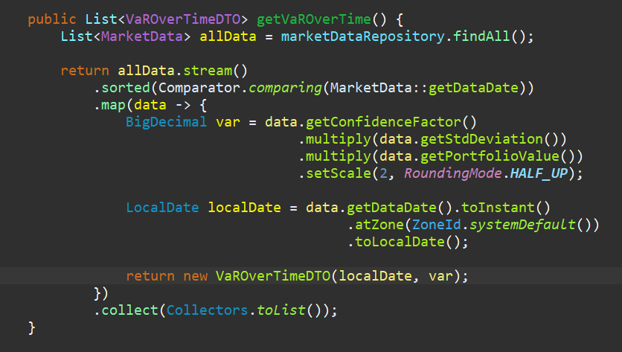
Code Snippets (BACKEND)
Formula used for computing VAR
Implementation of VAR using StreamAPI

Slide 12
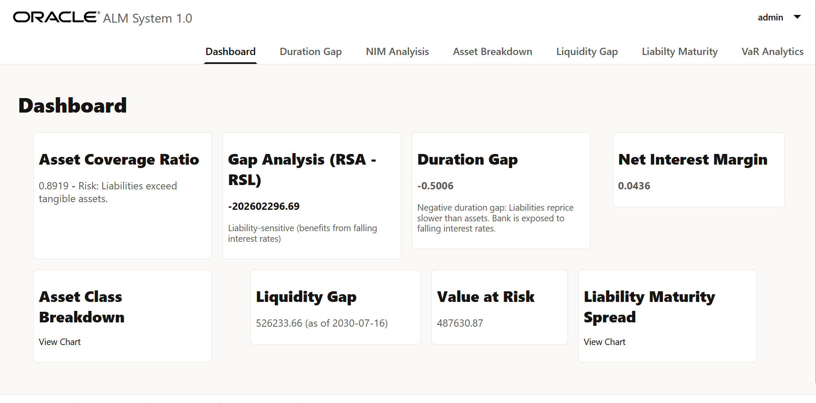
Dashboard

Slide 13
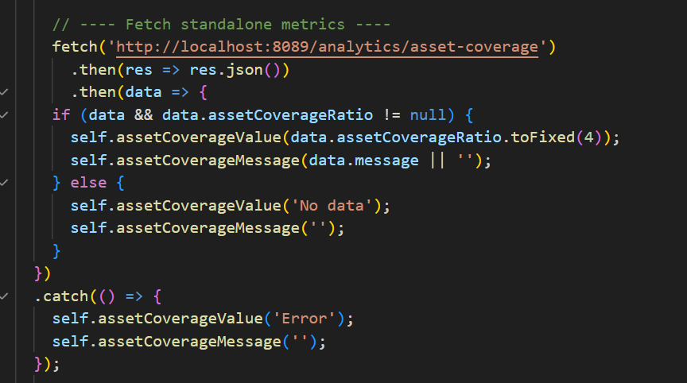
Code Snippets (FRONTEND)

Slide 14
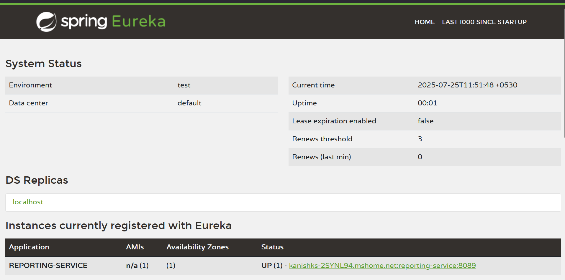
Service Discovery using Eureka Server

Slide 15
Static Code Analysis Tools
Overview
Purpose: Ensure robust code quality and maintainability in ALM system.
Tools used: Checkstyle, PMD, SpotBugs, Javadoc.
Tool | Purpose
Checkstyle | Enforces coding style rules (naming, formatting)
PMD | Detects code issues (unused variables, complexity)
SpotBugs | Finds runtime defects (null dereference, resource leaks)

Slide 16
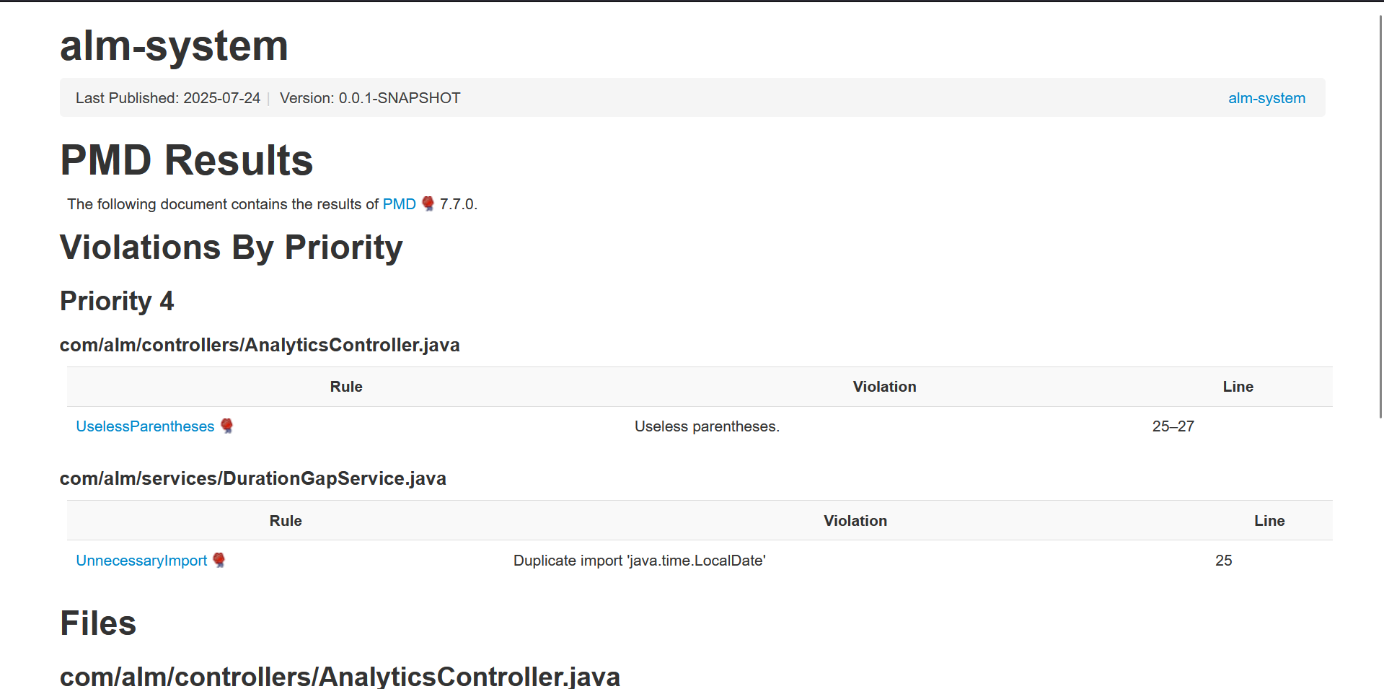
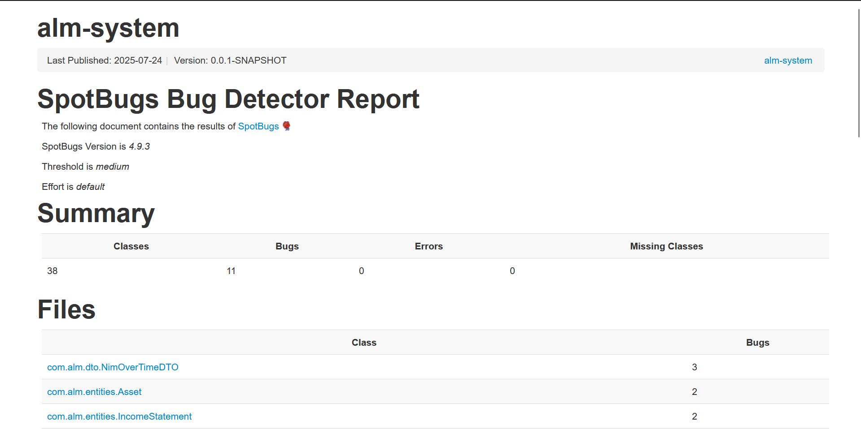
PMD & SPOTBUG REPORT:

Slide 17
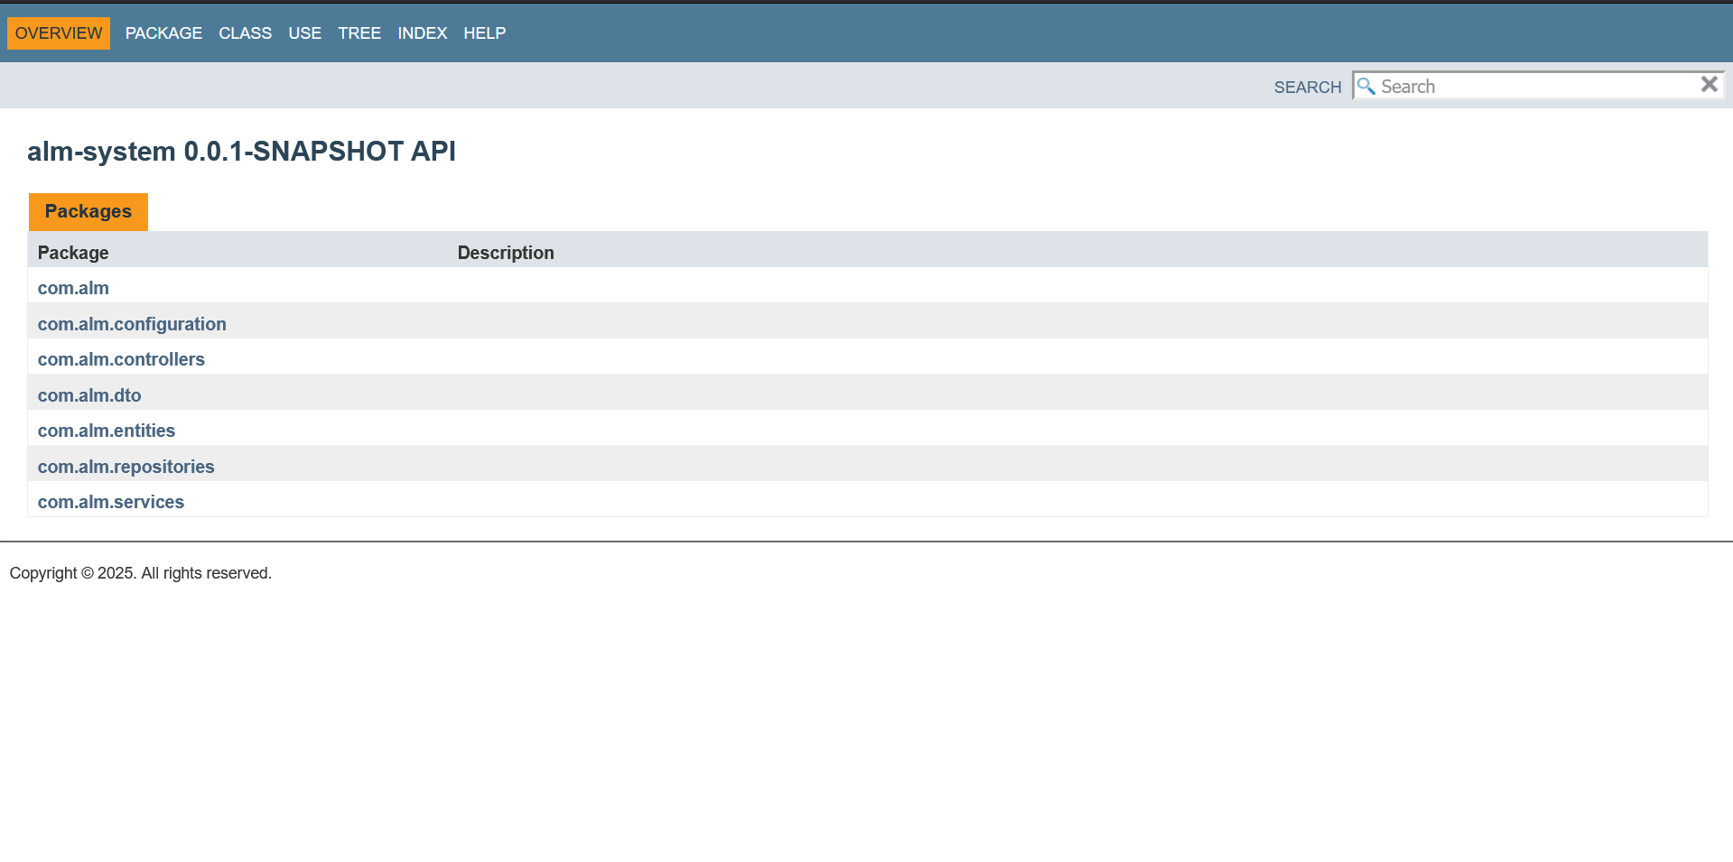
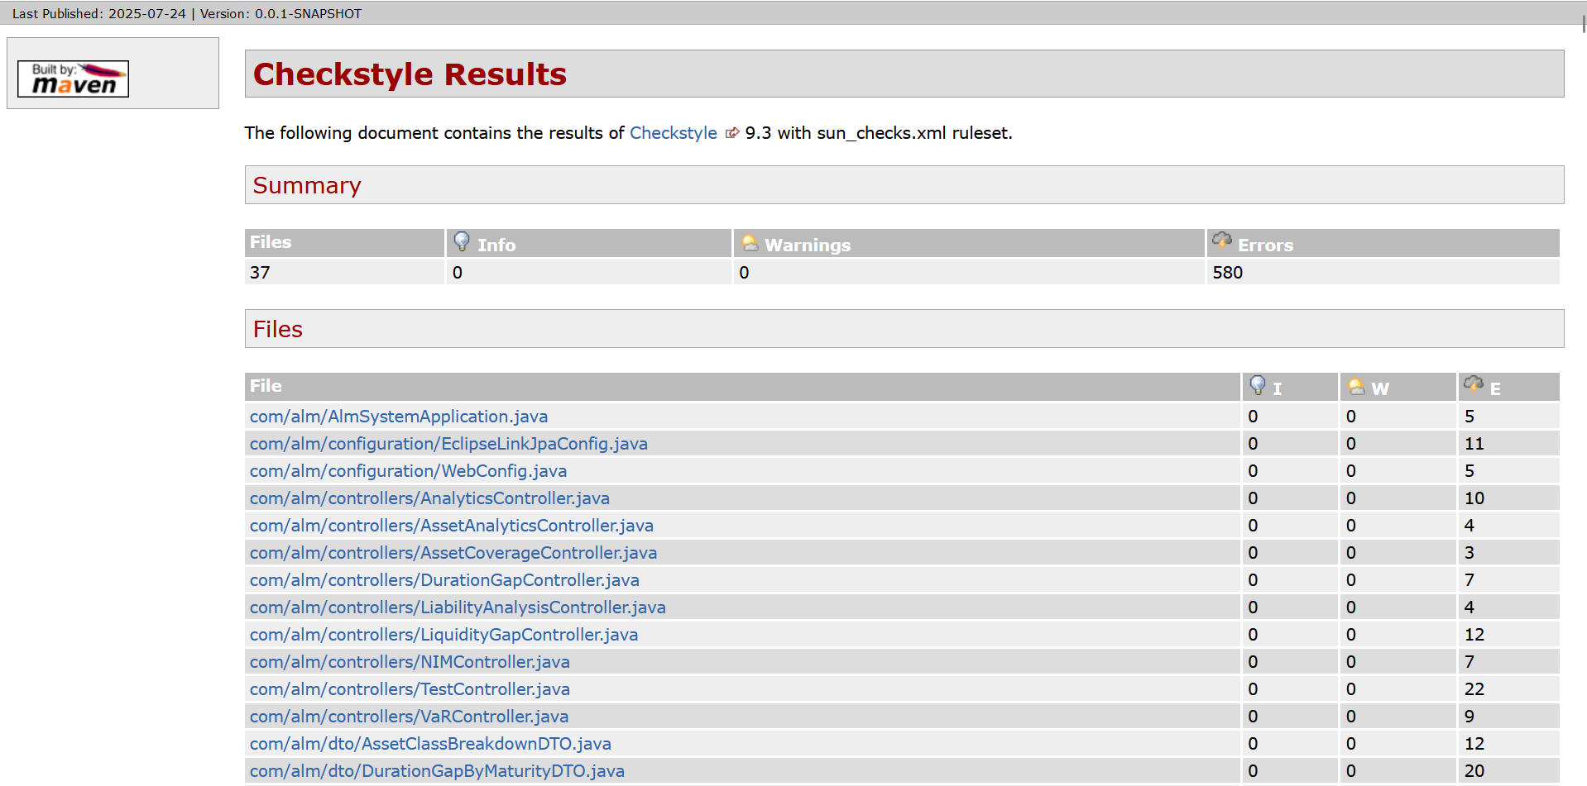
JAVADOC & CHECKSTYLE REPORT:

Slide 18
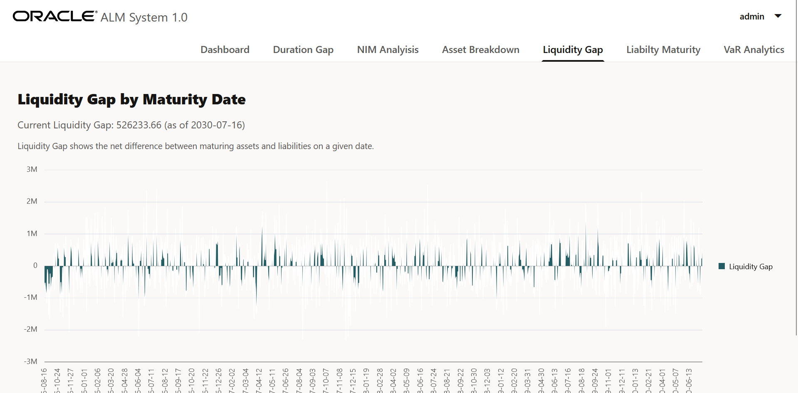
Useful Analytical Insights
1.Liquidity Gap

Slide 19
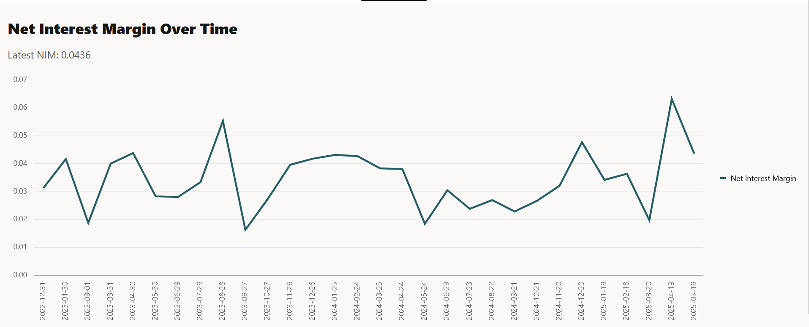
2.NIM ANALYSIS

Slide 20
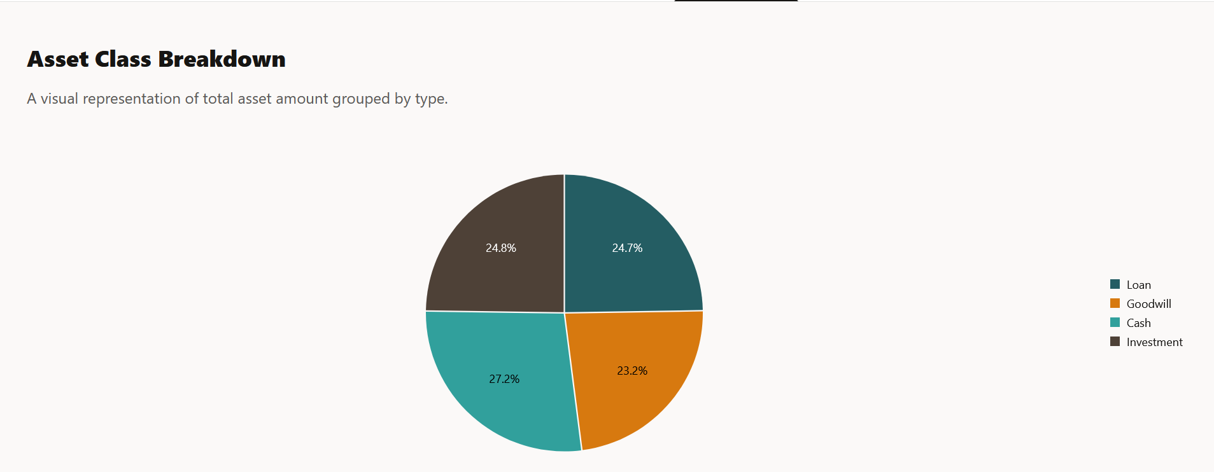
3.Asset Class Breakdown

Slide 21
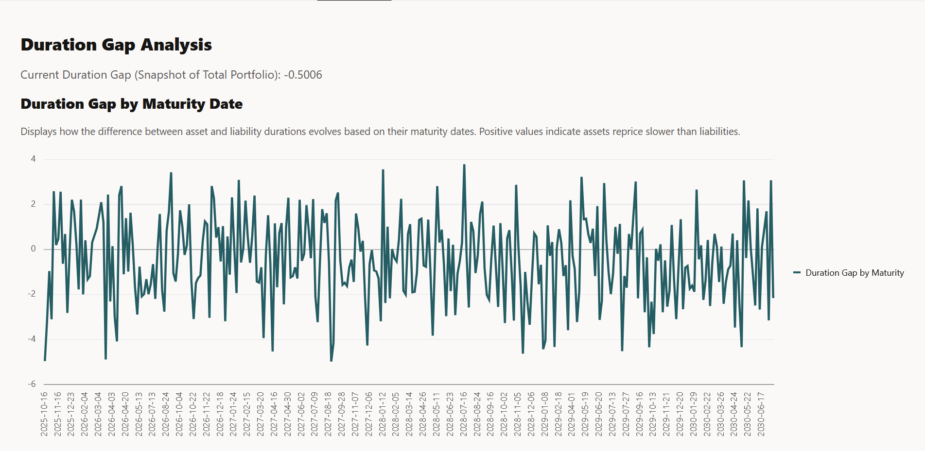
4.Duration Gap Analysis

Slide 22
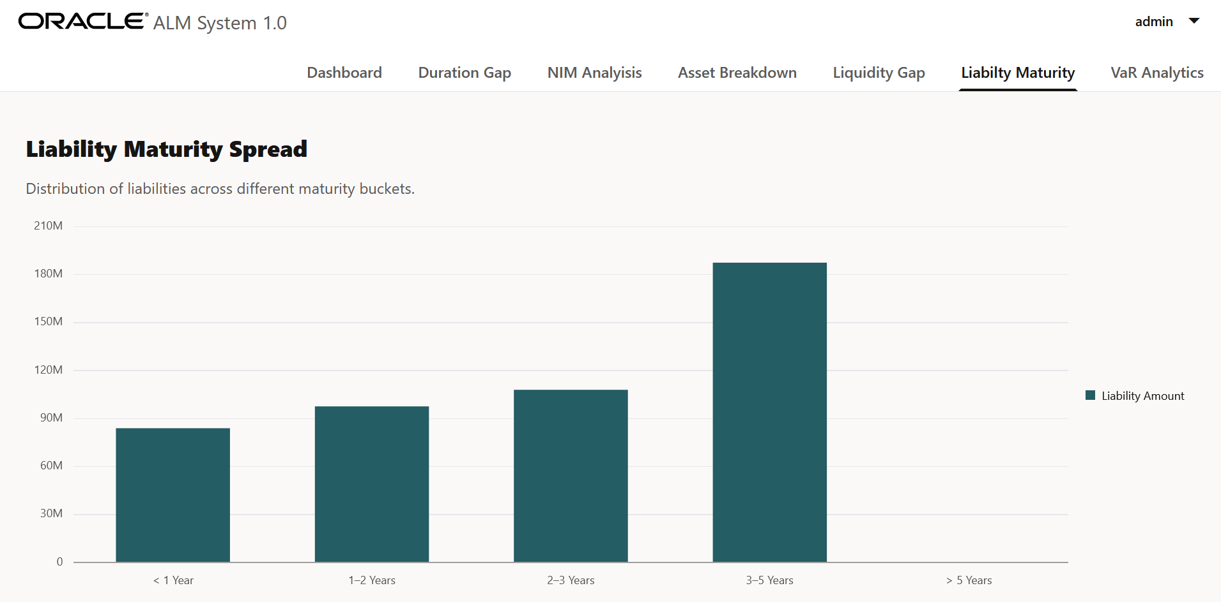
5.Liability Maturity Spread

Slide 23
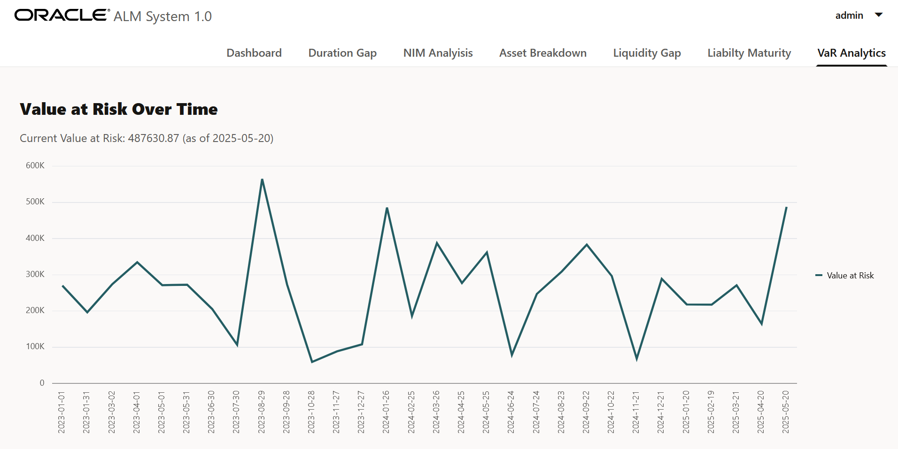
6.Value At Risk Over Time

Slide 24
Challenges Faced
Backend Logic Design Implementing financial calculations like Duration Gap, NIM, and VaR required precise formulas and domain understanding.
DTO Structuring Some services returned plain text initially; refactoring was needed for clean JSON responses compatible with the frontend.
Data Grouping & Bucketing Creating dynamic maturity buckets for liabilities and assets involved handling edge cases like missing or null dates.
API Consistency Maintaining uniform endpoint formats across diverse metrics (charts vs single stats) was essential but tricky.
Frontend Bindings Observables failed due to improper field access or missing bindings, especially for composite JSON fields.
Navigation and Routing Tile link routing (?oj r= format) didn't match navbar paths initially, requiring consistent router handling.

Slide 25
Key Learnings
Full-Stack Integration:- Learned to seamlessly connect Spring Boot backend services with Oracle JET frontend components via REST APIs
Debugging and Iteration:- Strengthened problem-solving through endpoint testing, browser console analysis, and iterative UI refinement.
Dynamic Binding with KnockoutJS:- Gained confidence using observables to dynamically update UI with real-time or fetched backend data.
Modular Architecture:-Built clean separation of concerns using DTOs, Services, Repositories, and Controllers for scalable development.
User-Centric Design Thinking:- Designed dashboards with both functionality and readability in mind — focusing on clarity before polish.
Data Visualization:-Utilized Data Visualization Techniques using Oracle JET charts effectively to represent financial metrics providing useful insights.

Slide 26

Thank you! Questions/comments

